Slide 1

Our Project
Arduino Based Car Parking System

Slide 2
Group 2
Group Name: Tech Turtles
Group Member
Md.Jiman- 202316101
Imam Hasan- 20231601
Osama Ahmed Ibrahim- 202316126
Md Humaun Kabir Nahid- 202216040

Slide 3
Introduction
An Arduino-based car parking system that intelligently manages both ingoing and outgoing vehicles. Utilizing sensors, the system accurately detects free spaces, guiding incoming cars for efficient parking. Additionally, it facilitates gate operations for outgoing vehicles, ensuring seamless exit processes and enhancing overall parking management.

Slide 4
Objectives and goals
Time Efficient Solution
Reduce Parking Stress
Reduce Search Traffic on Streets
User-friendly Interface

Slide 5
Importance and relevance of the project
This system is capable of finding the empty slots that are available for parking automatically. If the slot is empty in the automated car parking the new vehicles are allowed to enter the parking else the entrance is blocked by using the servo barrier in case no empty slot is found by the system. The visitors can see the status for the availability of the free space outside the parking on a LCD.

Slide 6
Methodology
Mount the ultrasonic sensor near the parking space entrance and the servo to control the gate.
Power the Arduino with the 9V battery or another appropriate power source.
Upload the code to the Arduino using the Arduino IDE.
Test the system by placing obstacles (simulating cars) in front of the sensor. The gate should open when an object is detected and close after a few seconds.

Slide 7
Weekly progress plan
Timeline
Week 1- Project structure Development
Week 2- IR Sensor Setup
Week 3- Motor Control and Movement Setup
Week 4- Setup Parking Logic
Week 5- Error Handling and Testing
Week 6- Final Testing and Documentation
Week 7- Project submit

Slide 8
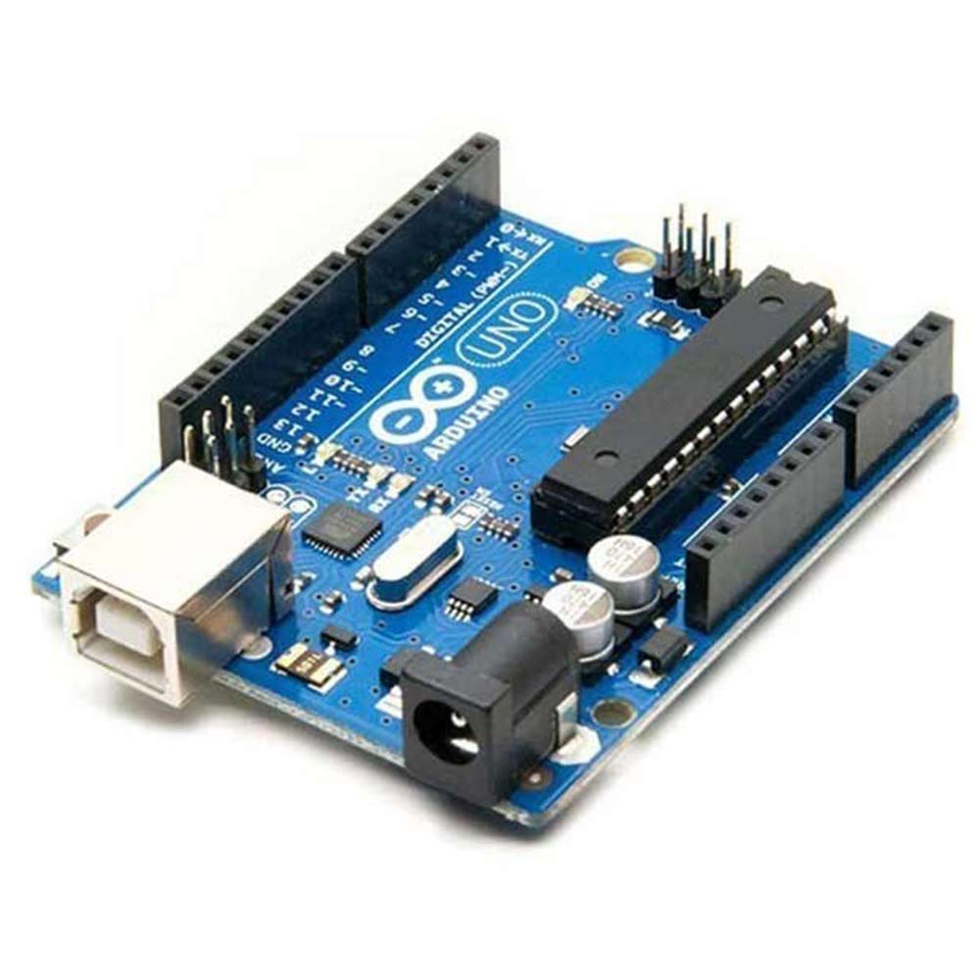
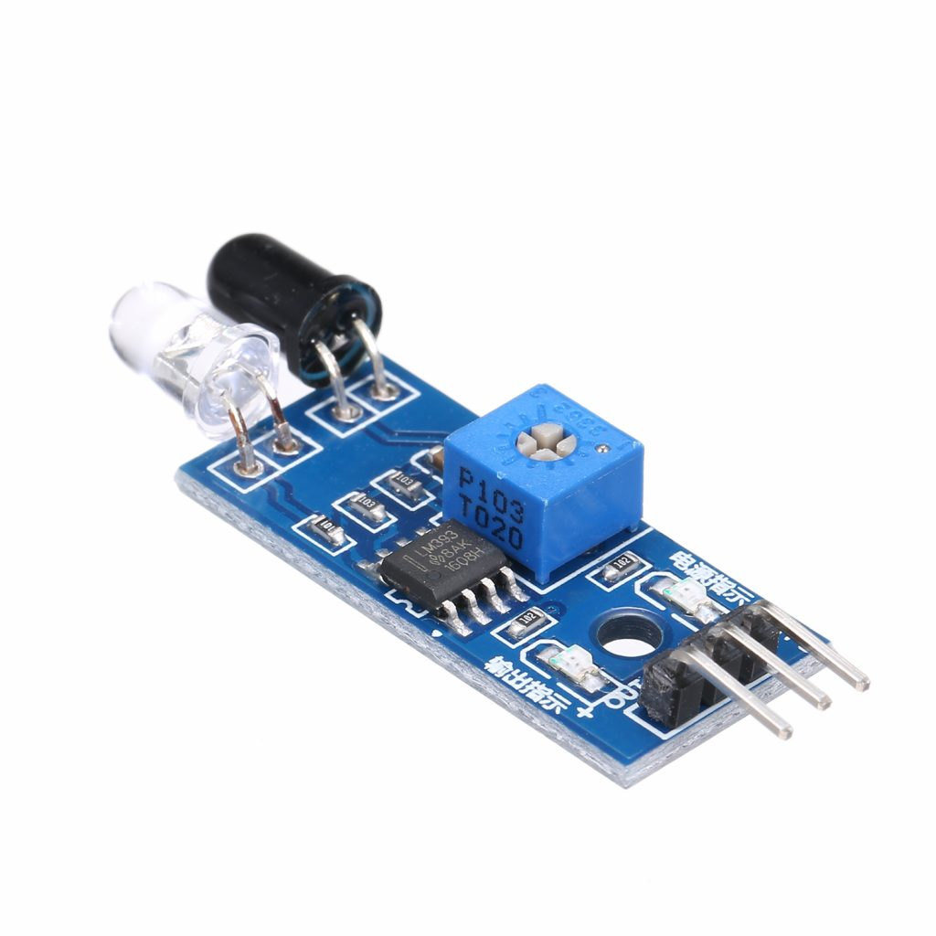
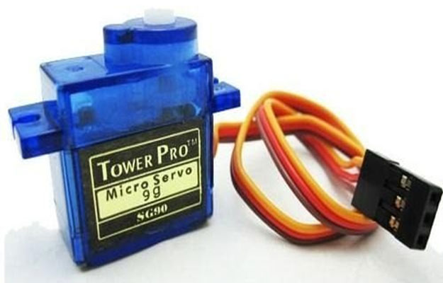
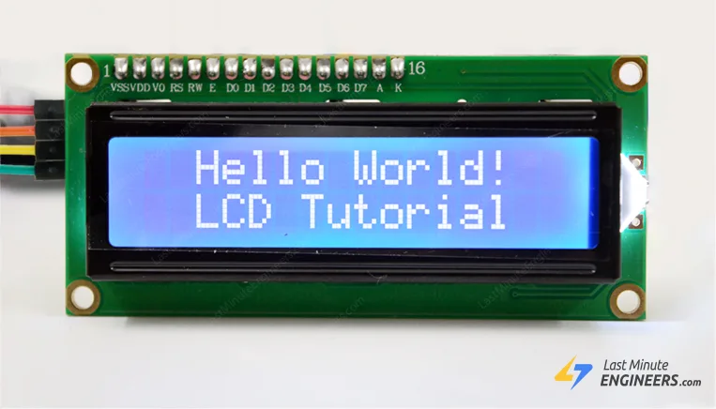
Budget
Component
Price
-Arduino-Uno
980 Tk
540 Tk
150 Tk
240 Tk
-Infrared-Proximity-Sensor
-Servo-Motor
-Arduino Interfacing-I2C-LCD

Slide 9

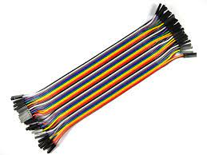
Battery 200 Tk
Jumping wire 160 Tk
Total 2270 Tk

